Slide 1
De Novo Photochemical Synthesis Of Non-Symmetric Pyrenes
Nikolas R. Dos Santos
Dr. Igor Alabugin
4th Year Talk
04.28.2022
Is non-symmetric important? Is it difficult to do? Never discuss non-symmetry in rest of presentation?
Notes:
-I would first like to thank everyone who’s here for their time.
-My talk today is on the….
-without further ado, let’s begin my proposal.

Slide 2
Aromatic fusions up to 4 rings
dd (AI: what is it??)
Notes:
-There are many different ways to connect 2, 3, and 4 aromatic rings together, but one stands out as special.

Slide 3
Why is pyrene interesting?
-Fluorescent Probes
-HOMO/LUMO gap- 3.8eV -Inherent emission at 375-410nm
-Organic Field-Effect Transistors (OFETs)
-Long lived singlet, S₁, leading to high excimer formation (>100ns)
-Organic Light-Emitting Diodes (OLEDs)
-Excimer Formation- changes emission to 425-550nm
-Organic Photovoltaic cells (OPV)
-High Fluorescence Quantum Yield, ϕ_{f}=0.29
-Chemical Biology
-Red. potential= 1.52V

Slide 4
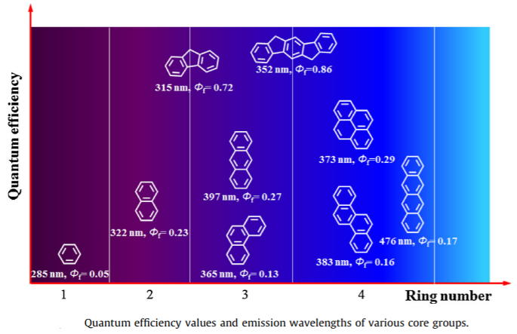
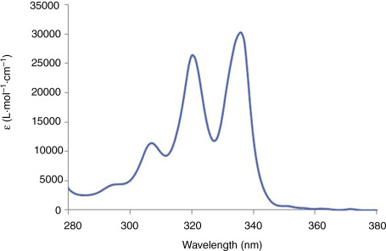
Photophysics
Kim et al., Mat. Sci. and Eng. 2016, 99, 1-22

Slide 5
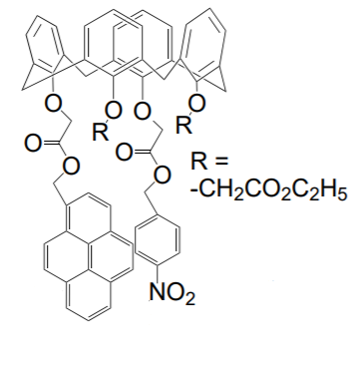
Pyrene in materials
Uses pyrene as the core for a semiconducting material in OFET due to its fluorescence.
Uses the interaction between pyrene and NO₂ as an optical sensor for Na⁺ detection.
Liu et al., Org. Electron. 2009, 256.
Draw this structure so you can pyrene blue
Uses pyrene to tune fluorescence of the molecule in OLED.
Diring et al., J. Am. Chem. Soc. 2009, 18177
Aoki et al., Chem. Commun. 1992, 730
Notes:
-in materials, pyrene has found uses as a bis-4-ethynylphenylaminoacyl pyrene derivative that could be used as a gel layer in OFETs.
-solution processable light-emitting molecular glasses in OLEDs.
- a pyrene containing calixarene used as an optical sensor for Na+ ions.

Slide 6
Strategies for synthesis of functionalized pyrenes
Strategy One
Functionalizing existing pyrene
R
R=alkyl, aryl, alkoxy, X
Notes:
-Although extremely useful, the methods for synthesizing pyrene with diverse substitution patterns are scarce. The few available methods rely on two main strategies.
-Strategy one uses pyrene as a starting material and then anneals functionalities to it.

Slide 7
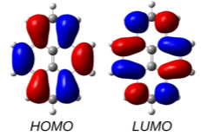
HOMO/LUMO
Sadeghi et al., Nano Lett. 2017, 4611
Notes:
-Before jumping into the different methods for employing strategy one, we must first understand the reactivity of pyrene.
-Pyrene has nodal planes in both the HOMO and the LUMO, which lie perpendicular to the molecule and pass through the 2‐ and 7‐positions. Maximum contributions of the HOMO can be found at the 1‐, 3‐, 6‐, and 8‐carbon atoms.
-We can then separate pyrene into two main regions. The Non-K-Region and the K-region.
-The non-k-region holds the electron rich centers of pyrene, which can be directly accessed by using electrophiles via EAS reactions.
-if two or three equivalents of an electrophile are used, the substitution pattern obtained is a statistical distribution of regioisomers.
-It is therefore difficult to prepare anything other than mono-substituted pyrenes or 1,3,6,8-tetrasubstituted pyrenes by direct electrophilic substitution.
-The 2 and 7 positions of pyrene are activated towards electrophilic aromatic substitution to a lesser extent than the 1, 3, 6 and 8 positions, but they can react selectively if a very bulky electrophile is employed..

Slide 8
Summary of direct functionalization strategies
Difficulty or complex to selectively substitute any positions beyond first substitution.
Notes:
-The K region of pyrene can be accessed directly through metal catalysis and EAS reactions when the non-k-region is blocked by bulky groups, and indirectly through the Hhpy method.
-The Non-K-region can then be accessed directly through EAS reactions focusing on positions 1,3,6, and 8. it can be substituted on the 2 and 7 positions through bulky electrophiles as well as through the Thpy method.

Slide 9
Strategy one: direct functionalization
Crawford et al., Chem. Commun. 2005, 2172
Grimshaw et al., J. Chem. Soc., Perkin Trans. 1972, 1622
Streitwieser et al., J. Chem. Soc. Perkin Trans. 1 1997, 1201
Mochida et al., J. Am. Chem. Soc. 2011, 10716
Filichev et al., Chem. Eur. J. 2008, 9968
Notes:
-examples can be seen by the di-bromination of pyrene, where after the first bromination step, the second bromination occurs as a statistical distribution of 2 different products.
-bromination and other EAS can be achieved at the K region by first reducing pyrene into HHpy. Such pathway requires a final re-aromatization step to be added. - another indirect method is possible, such as reducing py to THpy instead. Through this method, a biphenyl core is created, which followed by Friedel crafts reaction allow proper substitution at the 2,7 position of py. Other methods of C-H activation are also possible such as substitution of the K region by palladium catalized chemistry, and using a bulky iridium catalyst to functionalize the 2,7 positions of pyrene

Slide 10
Strategies for synthesis of functionalized pyrenes
Strategy Two
Assembling pyrene from smaller units (de novo synthesis)
Notes:
-The second strategy for the synthesis of pyrene employs assembling pyrene from smaller units. Below are 5 precursors to the synthesis of pyrene
-we will first talk about the 3 more well known ways, followed by 2 more recent advances.

Slide 11
Biphenyl photocyclization
Laarhoven et al., J. Chem. Soc., Perkin Trans. 1972, 2074
Notes:
-firstly, the photocyclization of 2,2’-divinyl biphenyls which proceeds through two biphenyl cyclizations yields aTHPy intermediate, which upon further oxidation as a second operation gives di-substituted pyrene products.

Slide 12
Bis-alkyne biphenyl cyclization
Walker et al., Synth. 2002, 8352
Notes:
-Secondly, o,o’-dialkynyl substituted biphenyls as starting materials by reacting them with PtCl₂ to give pyrene in moderate yields. -This method of using bis-alkyne has been broadly explored with other synthesis using ICl, as well as radicals such as SnBu3-H

Slide 13
Transannular ring closure
Casas-Solvas et al., Org. Biomol. Chem., 2014, 212
Notes:
-lastly, [2,2]metacyclophanes can be used as starting materials. In this method, an electrophile can be used to activate the transannular ring closure and even be incorporated into the THPy product. This THPy can then be further aromatized into pyrenes.

Slide 14
Summary of known strategies
Notes:
- Firstly beginning with the photocyclization of biphenyls, followed by usage of bis-alkynes, and lastly, the synthesis beginning with metacyclophanes highlights examples of these 3 precursors to pyrene.

Slide 15
Out with the old, in with the new
Strategy Two
Assembling pyrene from smaller units (de novo synthesis)
Known Strategies
New Strategies
New Strategies
Notes:
-Further, we can explore more recent methods for making pyrene.

Slide 16
Strategy two: recent advances- beginning from naphthalene
This can’t be categorized in strategy one or two?
Gonzalez-Rodriguez et al., J. Am. Chem. Soc. 2020, 8352
Notes:
-the first new advance was developed by Gonzalez-Rodriguez et al. in the Alabugin lab. This synthesis uses 1,4-disubstituted naphthalenes via a radical annulation by reacting them with Bu₃SnH in the presence of ACHN as a radical initiator. This shows an elegant synthesis beginning from napththalenes, a precursor that had never been previously explored.
-This strategy was used to make interesting products such as SnBu3 substituted pyrenes in 24-34% yields as well as further iodinating them in yields greater than 90%.

Slide 17
Strategy two: recent advances beginning from benzene.
This can’t be categorized in strategy one or two?
Kawade et al., Angew. Chem. Int. Ed. 2020, 14352
Notes:
Another method for pyrene synthesis developed in our lab was done by Kawade et al. This strategy uses a three-point annulation that converts benzenes into pyrenes.
This procedure was used to synthesize interesting di-substituted pyrene products as well as benzo[]picenes and dibenzo[]tetraphenes.
Although giving pyrenes in moderate yields of 48-68%, this strategy relies on the complex synthesis of the starting precursors, as well as complex three-part procedure to yield the desired products.

Slide 18
Summary of all current pathways to pyrene
Strategy Two
Assembling pyrene from smaller units (de novo synthesis)
Notes:
-This completes the summary of known precursors used to make pyrene from a de novo synthesis.

Slide 19
One missing approach
Strategy Two
Assembling pyrene from smaller units (de novo synthesis)
Notes:
- By looking at each specific starting material for each precursor one can find one missing approach

Slide 20
De novo photochemical synthesis of non-symmetric pyrenes
Make transition from other peoples work to your work very clear
Issues with previous methods include…
Goal of this project is to make … with improved….
Short synthesis
Do you want all three products? Why do you propose all three? Highlight goal product?
Notes:
This brings us to our main topic of the day.
The previous precursors, although very useful, all have their flaws. Either that be on the long synthesis of starting materials, complex reaction conditions, or multiple steps to arrive at the final pyrene target. -The goal of this project is to make pyrene in a much simpler way.

Slide 21
Retrosynthetic analysis
E and Z isomers interconvert under photochemical conditions
Notes:
By using retrosynthetic analysis, we can break down pyrene, step by step to come up with the simplest starting material for this transformation. This starting material requires a very specific geometry, thus we may have to find a way to begin with a simpler isomer for this transformation.
After coming up with a simple starting material, we then continued our retrosynthesis to decide on the easiest way to make it and that gave us the styrene and the 1,3-dibromobenzene on the right.
We decided that a double heck reaction would be the easiest way to obtain the starting material from commercially available substrates. the problem here is that the heck reaction would give us a combination of different isomers, however only one of those isomers would be able to proceed to pyrene.
Photochemistry provided us with a simple solution to this problem. Under these conditions, all isomers would be able to interconvert and would be equivalent to us.
We planned to accomplish this with conditions consisting of light, and an oxidant to re-aromatize after each cyclization.

Slide 22
Precedents for the first step: the Mallory cyclization
Break down more and add animations. This is too much information to present at once
Should precedents go before retrosynthetic analysis?
…because we know these methods exist we plan to try to obtain our desired products using … (retrosynthesis)
Should background slides look at photochemical cyclization so this precedents could be presented before your research?
Is methods to make pyrene the main point of your talk or photochemical cyclization?
Mallory et al., Org. React. 1984, 30
Notes:
- The Mallory photocyclization of stillbenes proved to be a simple and efficient precedent for the first cyclization. -by using light, a stilbene can photoisomerize, and through a 6pi electrocyclization followed by a re-aromatization step, a fully aromatized phenanthrene product can be achieved.

Slide 23
The first step is easy: the Mallory cyclization
Add yield to katz’s work
Katz and coworkers, Tetrahedron Lett. 1986, 2231.
100’s of examples
Mallory et al., Org. React. 1984, 30
Notes:
-Katz then published a slight variation to this method. using equimolar amounts of Iodine, and using methyloxirane to quench HI formed to prevent side reactions. 100’s of examples have emerged from this method and show the easy with which the first step should occur.

Slide 24
Precedent for the second step, is it even possible?
Katz and coworkers, Tetrahedron Lett. 1986, 2231.
Laarhoven et al., Tetrahedron 1969, 1069
Morgan et al., Tetrahedron Lett. 1970, 4347
Notes:
-The second step in our synthetic plan is much more complex. Literature leads us to ask the question if it iseven possible. Laarhoven and morgan performed a double Mallory-photocyclization on meta-bis-distyrylbenzenes and obtained product 1 in 70-78% yield. -interestingly, trace amounts of 2 other products were also obtained, with 3 being the goal of this work.
-Their work found around 70% of 2, and trace amounts of 1 and 3.
-We repeated these experiments from Laarhoven and Morgan and found similar results.

Slide 25
Why is pyrene the minor product?
Notes:
The formation of the products above can then be described beginning with a choice between two different Mallory cyclizations. Cyclizing para to the styryl group gives the 2-substituted phenanthrene shown.
Cyclizing towards position 3 of phenanthrene gives product 2 and cyclizing towards position 1 gives product 1
Going back to the initial 2 Mallory cyclizations, cyclizing ortho to the styryl group gives a bay-region substituted phenanthrene.
This phenanthrene can then yield product 1 via another Mallory closure, OR via a distinct cyclization to yield product 3.

Slide 26
Redirecting reactivity: blocking a favorable reaction
Notes:
Although documented, formation of 3 is practically an unknown reaction with only trace amounts being reported in only 2 papers.
The question became, how could we stop the reaction that is usually dominant, closing the doors to products 1 and 2 and forcing product 3 to be the major product?
To do so, we had two challenges to overcome. 1: eliminating the possibility of the initial para- cyclization.
And 2: eliminating the possibility of the second Mallory closure, giving pyrene as the sole product.

Slide 27
Solution: The blocking groups
Commercially available starting materials
Two-step synthesis.
Notes:
To do so we envisioned the use of simple R blocking groups to direct both closures towards the intended pyrene product.
This small change converts a very inefficient process into a useful synthetic tool to the synthesis of tetra-substituted pyrenes.

Slide 28
Initial studies
Do we need so much background on pyrene or could you just do one slide of pyrene/the newer methods from our lab and then go into precedents for your research? Because we are over halfway through the slide deck and just now getting to initial studies.
E- and Z-isomers interconvert under photochemical conditions
Notes:
-We began our studies by making the meta-bis-styrylbenzenes through a simple double heck reaction.
-Our preliminary studies found that such reactions proceeded with 10 mol % of Pd (OAc)2, 4 equivalents of triethylamine and 30 mol% triphenylphosphine dissolved in acetonitrile at 100°C over-night to provide the required bis-stilbenes in 70-80% yields. These conditions were optimized to our uses to give the best possible yields to our substrates. We obtained the products as a mixture of stereoisomers, which would be equivalent under photochemical conditions.
-Our initial studies found R=OMe blocking groups have given a sole product of two Mallory cyclizations.
-we obtained that product in 75% yield.

Slide 29
Not all blocking groups are equal
Notes:
-Since R=OMe did not work, we decided to use a more robust R=Me blocking groups.
-Unlike the earlier discussed example, the formation of pyrene is more favorable than a 2nd Mallory cyclization giving a benzo[c]chrysene derivative.
-To our delight, the Me-substituted precursors readily form the expected tetrasubstituted nonsymmetrical pyrenes upon irradiation in the presence of I₂ and methyloxirane.

Slide 30
A new reaction- double photocyclization followed by Ar-shift
Notes:
-Surprisingly, the photochemical cascade of substrate with the Me-blocking group proceeds even further via a formal 1,2-aryl group shift for R’=OMe.
-this means that not only a new discreet cyclization from a Mallory reaction was discovered, but also a never before seen aryl shift in stilbene cyclizations.

Slide 31
Mechanistic background for the aryl shift
Cold
Room Temp.
Lewis et al., J. Org. Chem. 2005, 10447
Notes:
-in order to gain better understanding to our reaction mechanism, we have turned to the literature to find any reports of similar transformations that would explain the formation of both of our different products.
-Lewis et al. have shown in 2005 that the photocyclization of vinyl-biphenyl is finalized through a competition of a 1,5-H shift versus two 1,2-H shifts. Experimental results using deuterium labeling have shown that, while at lower temperatures the 1,5-H shift prevails, at room temperature the preferred pathway involved two consecutive 1,2-H shifts.
-Our proposed mechanism emerges based on this concept.

Slide 32
Proposed mechanism
R=Me: ΔG (ΔH)
Energies in kcal/mol, M06-2X(D3)/6-311++G(d,p) Int=UF
Notes:
-It begins at the bis-stilbene precursor A, followed by 6π-electrocyclization and oxidation to give B.
-another 6π-electrocyclization gives structure C, which splits the mechanism in 2 different directions.
-The first pathway shows the mechanism for products lacking the formal 1,2-Ar shift which proceeds via two separate 1,2-hydrogen shifts to give E, and final oxidation to give the final product F.
-we envision a similar mechanism for the 1,2-Ar shift. For this pathway, we propose that after formation of C, a formal 1,2-Ar shift will give intermediate D’, which will then form E’ via 1,2-H shift, and finally be oxidized to product F’.

Slide 33
The blocking group is not perfect
Notes:
-Often in chemistry nothing is ever perfect, and as such, neither are these blocking groups. -although the desired product was formed as the major product, a previous product has came back to haunt us in varying ratios. -for H, as well as simple Me styrenes major pyrene product was formed in 5:2 ratio to chrysene product 4. this ratio seemed to suffer upon addition of stericly hindered t-bu styrene as well as electron withdrawing chloro styrene. This ratio seemed to improve once again upon use of electron donating methoxy substituted styrene, giving a separate migrated product.

Slide 34
Is sterics the solution?
Notes:
- Could the Blocking group be made more efficient at directing the second cyclization by making it larger and creating more steric bulk?

Slide 35
New problem: the starting material is unfavorable to make— re-optimization
Notes:
-This led us to a new problem. While the double heck reaction of the methyl core di bromo benzenes proceeded cleanly, for the more bulky cores this reaction did not work. -further optimization was required, and upon analyzing different catalysts such as Pd tetrakis and PdCl2(PPh3)2, as well as other solvents such as toluene, benzene, cyclohexane, hexanes, and DMF, new conditions for the double heck reaction were found. These consisted of a simple change to a much more suited solvent, DMF, which allowed the synthesis of distyrylbenzene precursors in 30-45% yield.
- t-bu cores were also attempted during this optimization process but only showed trace amounts of product formed.

Slide 36
Larger blocking groups do not impact selectivity
Notes:
-not all hypothesis are correct and the results of these studies showed that larger blocking groups do not impact reaction selectivity. -rations of formation of pyrene vs double Mallory product did not change significantly within similar R’ groups. -perhaps the reason for these findings is that although the blocking group is more protected with more steric bulk. Et and i-Pr would form better leaving groups than Me. Thus offsetting this selection

Slide 37
Things to explore
Find what happens with the eliminated blocking group
Comparing relative reactivity of styryl groups
Notes:
-with these findings in hand, new ideas must be explored. Firstly: -secondly:

Slide 38
Conclusion
Notes:
-Herein we propose a new method for the synthesis of non-symmetric tetrasubstituted pyrenes.
-This synthesis make use of a double heck reaction for 1 step synthesis of starting materials. Which upon irradiation, lead to 3 separate outcomes. - in the first outcome, when using MeO blocking groups, or as a side reaction with more sturdy groups, double Mallory reaction still occurs.
-secondly, we have shown a New double photocyclization cascade ending in the synthesis of substituted pyrene. -and lastly, and arguably the most intering case, a new double photocyclization with a aryl shift was discovered.

Slide 39
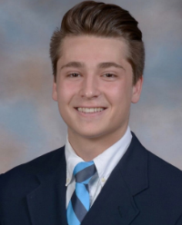
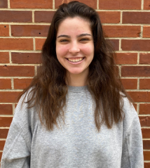
Acknowledgements
Principal Investigator -Dr. Igor Alabugin Post-Doctorate -Rahul Kawade Graduate (left to right) -Edgar Gonzalez-Rodriguez -Febin Kuriakose -Chaowei Hu -Adam Campbell -Michael Maxwell -Leah Kuhn -Quintin Elliott (not in picture) Undergraduates (left to right) -Morgan Skala -Curtis DeShong -Miguel Abdo -Jordan Suarez -Patricia Mehaffy Crystallography
-Xinsong Lin
Alabugin Group
Team Dos Santos -Angel Chu
-Alexandria Palazzo
-Josef Maselli
Notes:
-I would like to send my acknowledgements to my group, as well as to my PI, Dr. Alabugin, my undergrads Alexandria Palazzo, Angel Chu, and Josef Maselli, and to Xinsong Lin for all his help with Crystallography.

